Slide 1
Engaging and motivating students with real-world problems in STEM teaching
Dr. Mohsen Davoudi
Electrical Engineering Department
Imam Khomeini International University

Slide 2
Topics
What are the real-world problems in Engineering?
Measurement in Industry
Course of Advanced Measurement in University
Measurement Problems in Real World
Skills Learned through the Online Course
Course Project Examples
Conclusion
Notes:
The teacher starts the lesson describing the topics he/she will cover. All lessons always start with this formula: "In this lesson we will talk about: Topic 1 Topic 2 Topic n”.

Slide 3
The real-world problems in Measurement Engineering?
Measurement in Industry
Simple in preview but complicated in implementation
High level of experience needed to face measurement problems
Hard to transfer the experience to the young people
Laboratory experiences are not enough

Slide 4
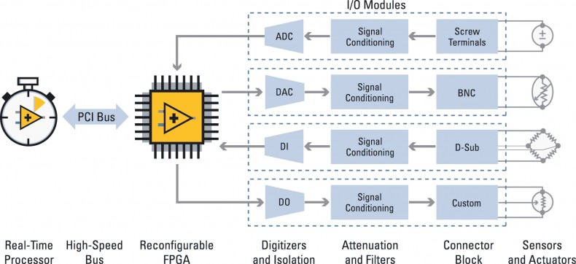
Advanced Instrumentation Course Coverage
CompactRIO Data Flow Diagram, courtesy of NI
Real-time Control
Digital Design
Advanced Instrumentation
Digital Control
Instrumentation
Microprocessors
FPGA/VHDL/Verilog
Electrical Measurement
DSP

Slide 5
Assessment
Final examination (50%)
Course Project (40%)
Quiz/Homework(10%)
Extras:
5% Extra for students with no absence
10% Extra for Implementing Instrumentation ideas on hardware (Analog/Digital)
10% Extra for an accepted paper in an ISI journal written from your project
Course Project:
Select a project in your field of interest (due: End of February)
Submit the final report including all of the programming files to mohsen.davoudi@gmail.com (due: 15 September 2022)
P.S. If your project solves any problem in industry,
you will receive 5% extra points too.

Slide 6
Projects Proposal
20 Projects + your own ideas

Slide 7
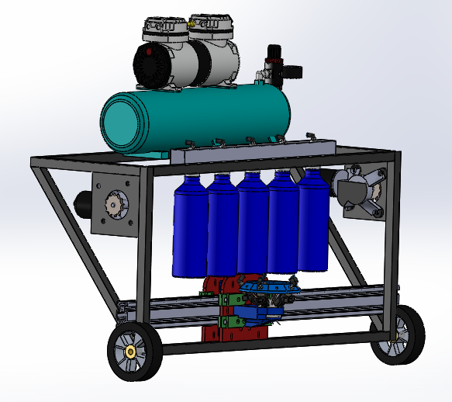
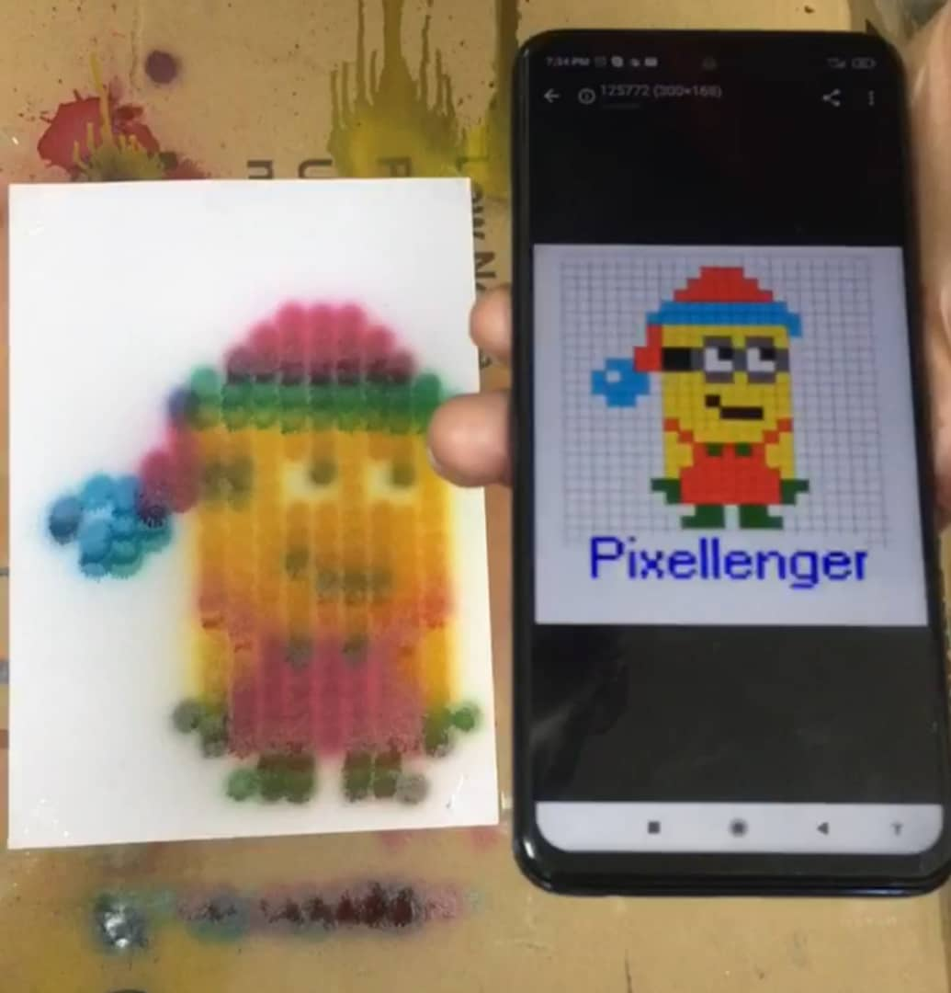
5. Spray Printer robot
The robot prototype is available
Optimize the robot structure
Develop the code to control robot
Develop the MATLAB/LabVIEW code for Image processing
Good level of Altium PCB design
Good level of the SMD soldering
ARM programming knowledge (WiFi Module)
Good level of MATLAB/LabVIEW Image processing
Mechanical modification workshop access

Slide 8
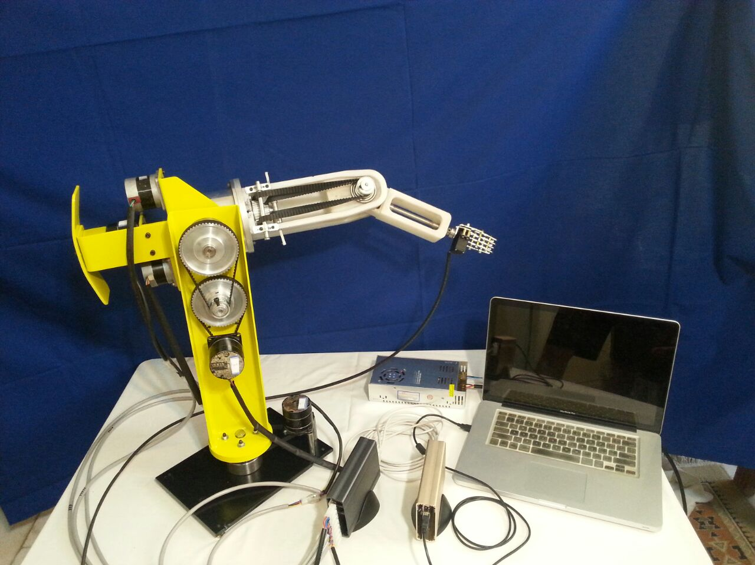
6. Manipulator Robot Control
Write the micro step control code for stepper motors in AVR.
Connect the AVR to MATLAB.
Model the robot in MATLAB.
Write code in MATLAB to control the robot to the destination point (X,Y,Z).
Interested in Kinematics of the manipulator
Good level of AVR coding

Slide 9
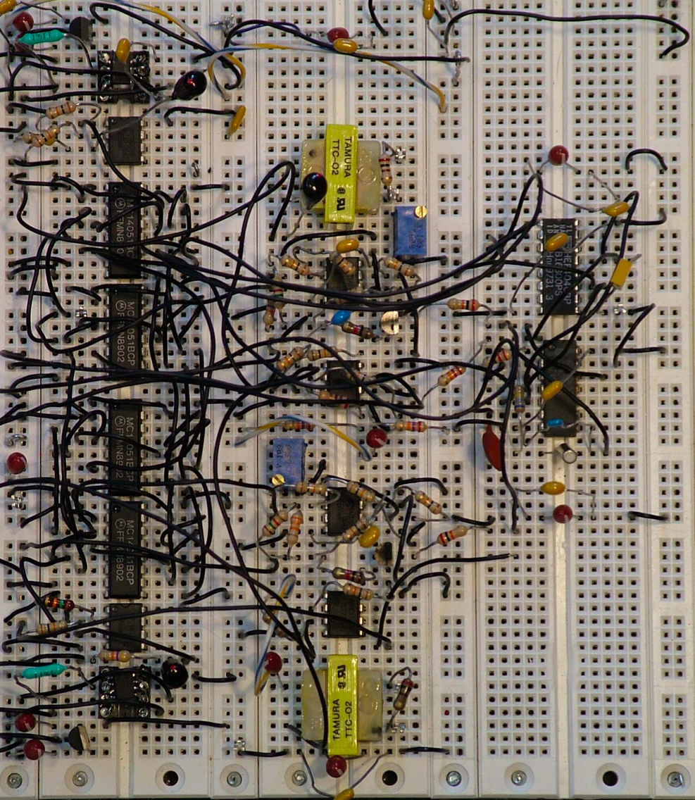
Prototyping Possible Choices
Bread Board
Pros: The fastest way for prototyping
No need for soldering
Good for simple circuits
Low current leakage
Easy to debug
Very flexible to change circuit
Cons: Only DIP components
Weak & unstable connections
Relatively expensive
Huge wiring for normal circuits
Terrible for final product

Slide 10
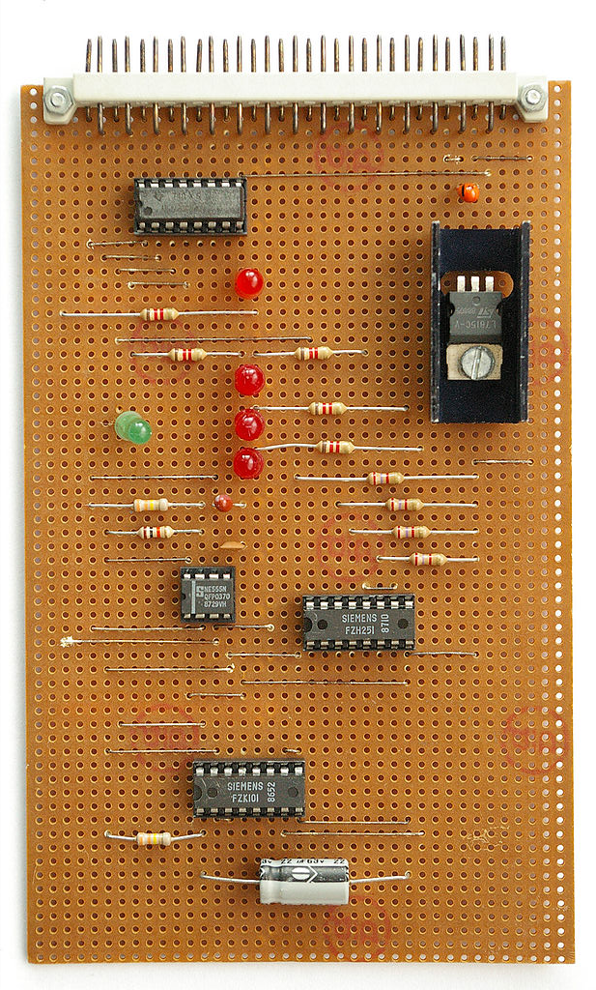
Prototyping Possible Choices
Strip Board
Pros: A fast way for prototyping
Relatively Cheap
Good for simple circuits
Flexible to change circuit
Acceptable for some final products
Cons: Only DIP components
Difficult wiring/soldering
Higher current leakage
Huge wiring for normal circuits
Hard to debug

Slide 11
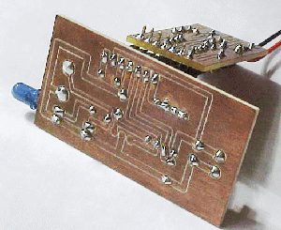
Prototyping Possible Choices
Manual Printed Circuit Board (PCB)
Pros: For DIP/SSOP/PQFP components
No need for wiring
Good for simple/normal circuits
Low current leakage
Good for some final products
Not so hard to debug
Cons: A slow way for prototyping
Relatively expensive
Needs soldering
Not flexible to modify circuit
Not easy for SMDs.

Slide 12
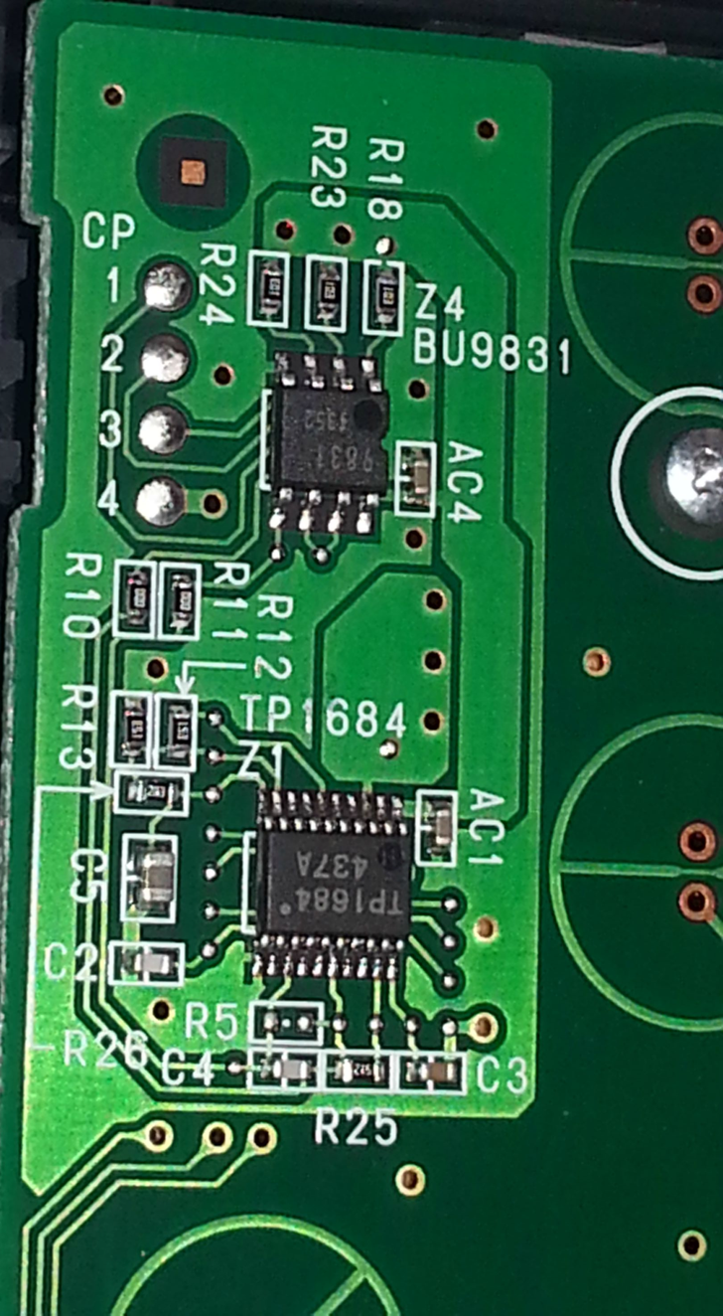
Prototyping Possible Choices
Printed Circuit Board (PCB)
Pros: For all kinds of components
No need for wiring
Good for normal/huge circuits
Lowest current leakage
Good for all final products
Not so hard to debug
Cons: The slowest way for prototyping
The most expensive
Needs soldering
Not flexible to change circuit

Slide 13
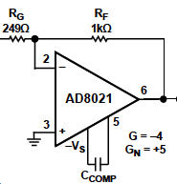
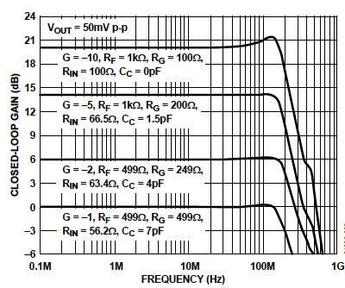
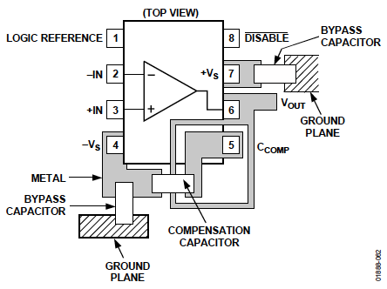
Example: AD8021 Op-amp
External Compensation Capacitor
Recommended Location of Critical Components and Guard Ring

Slide 14
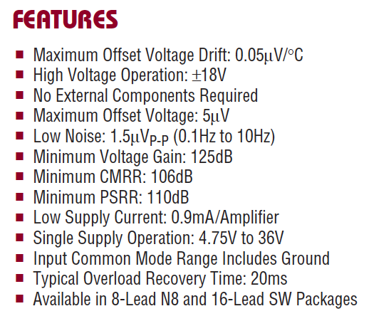
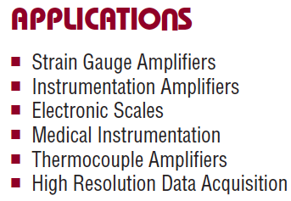
Example: LTC1151 Op-amp

Slide 15
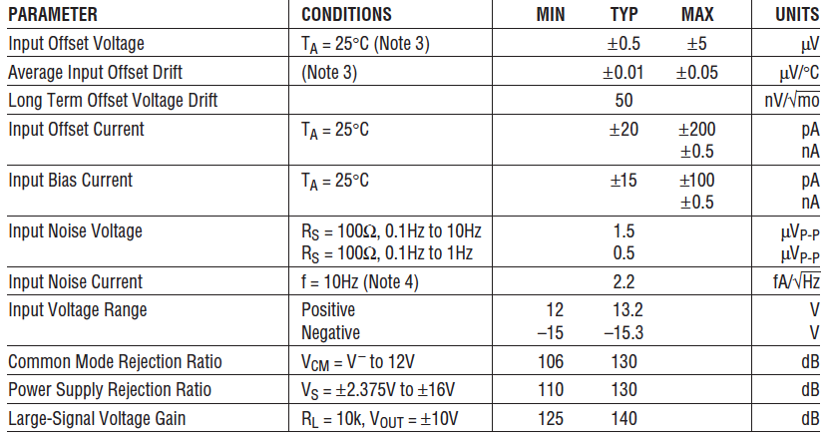
ELECTRICAL CHARACTERISTICS TA = 25°C. VS = ±15V

Slide 16
A Real Op-Amp Datasheet
Students Material \ Datasheet \ LM358.pdf
Students Material \ Datasheet \ AD8021.pdf
Home work: Read the above Op Amps datasheets and compare the general specifications.

Slide 17
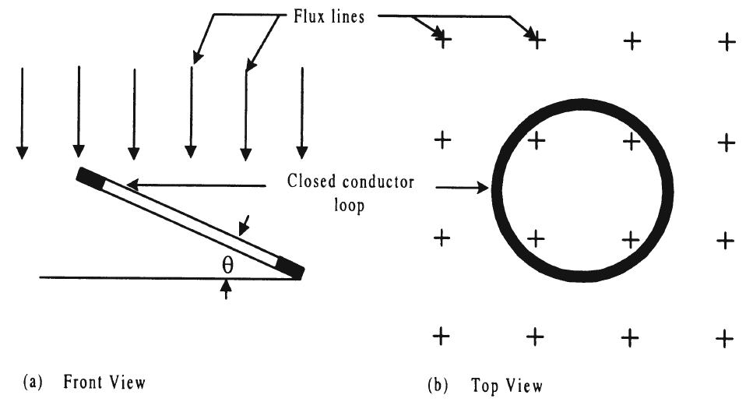
Another Example: Minimization of Inductively Coupled Noise
Consider two conductors in the vicinity of each other. When one of them carries a current, the flux due to it links with the second.
As the current in the former changes, the flux linking the latter also changes and induces an emf in it, which appears as a mutually coupled noise.

Slide 18
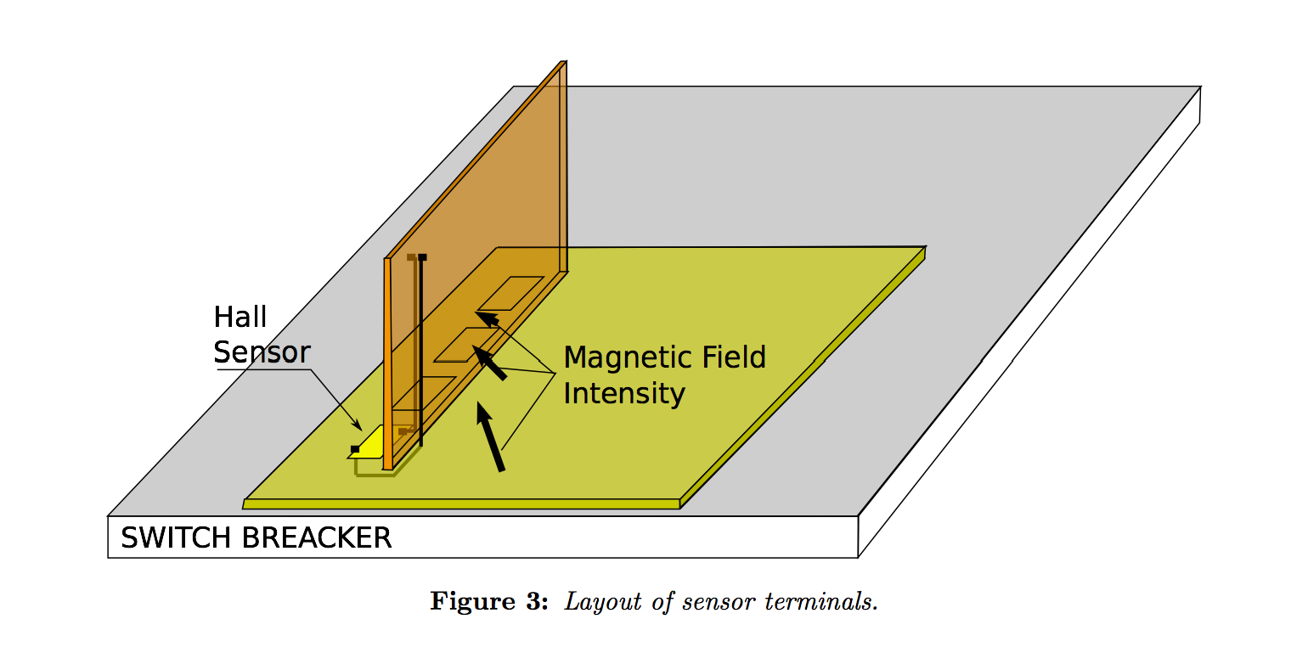
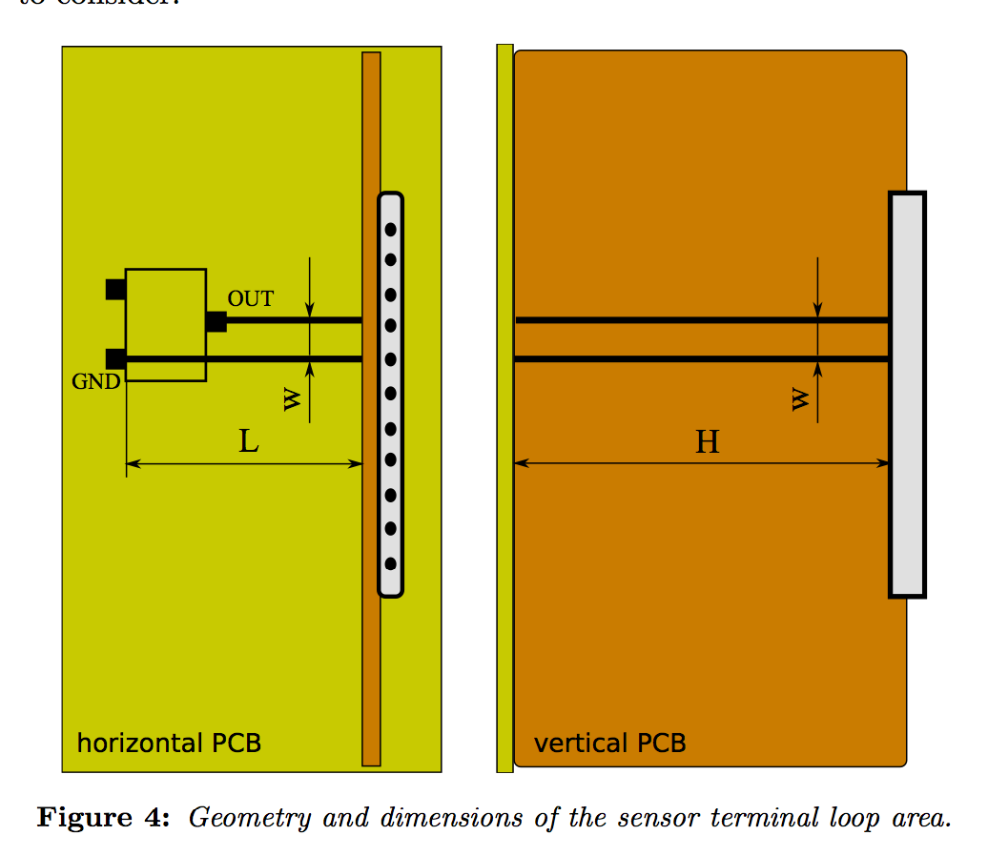
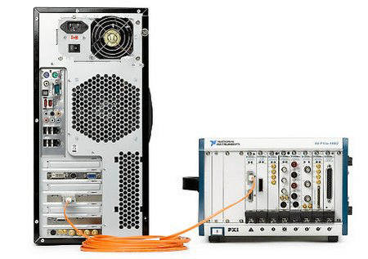
ABB Project

Slide 19
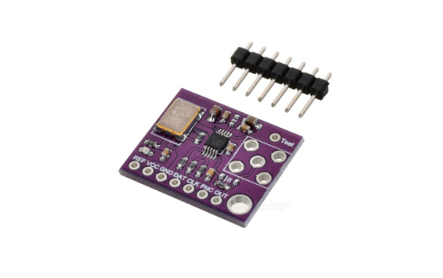
One more Example: Waveform Generation Using AD9833
Features:
Digitally programmable frequency and phase
0 MHz to 12.5 MHz output frequency range
28-bit resolution: 0.1 Hz at 25 MHz reference clock
Sinusoidal, triangular, and square wave outputs
2.3V to 5.5 V power supply
No external components required
3-wire SPI interface

Slide 20
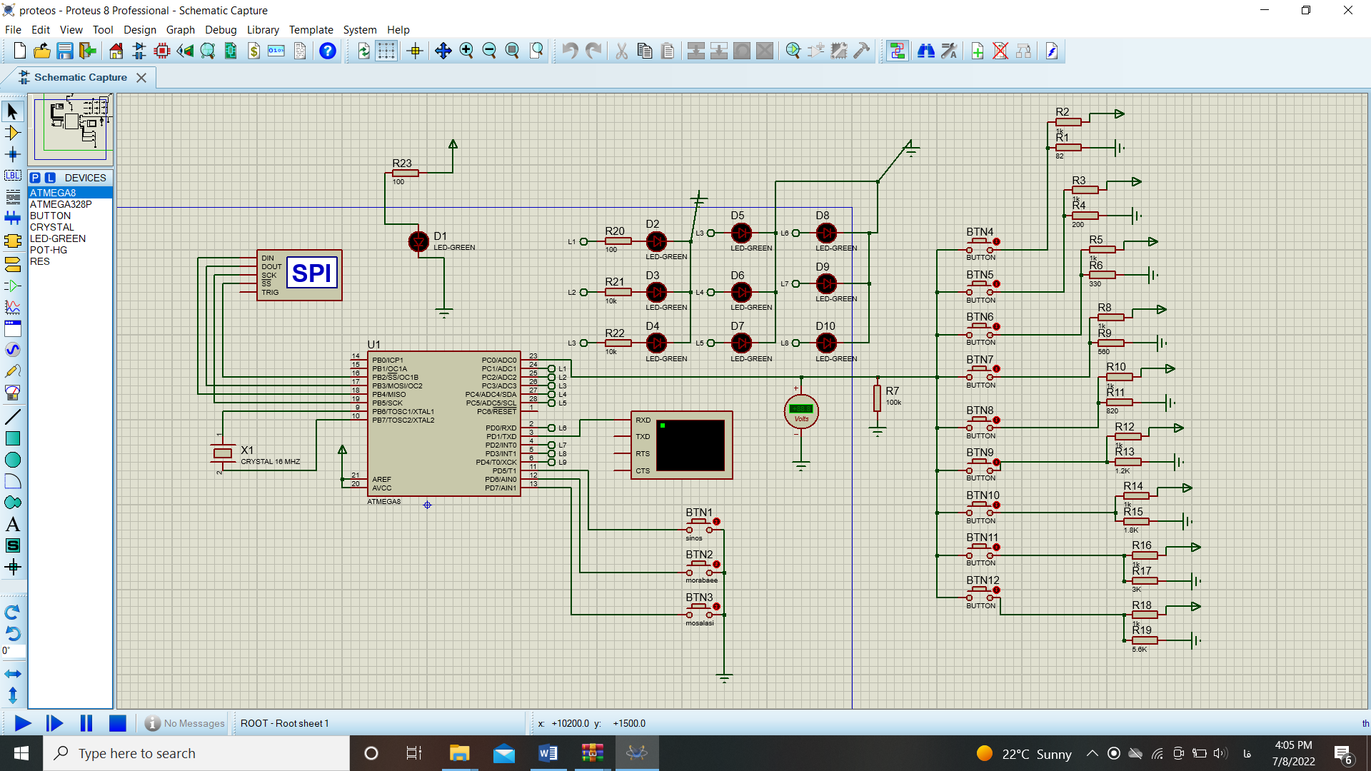
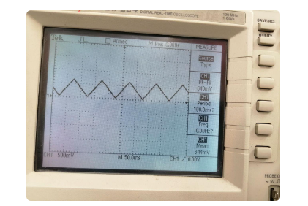
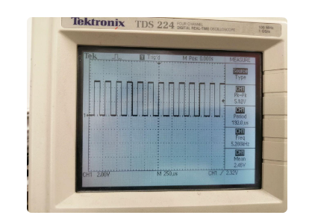
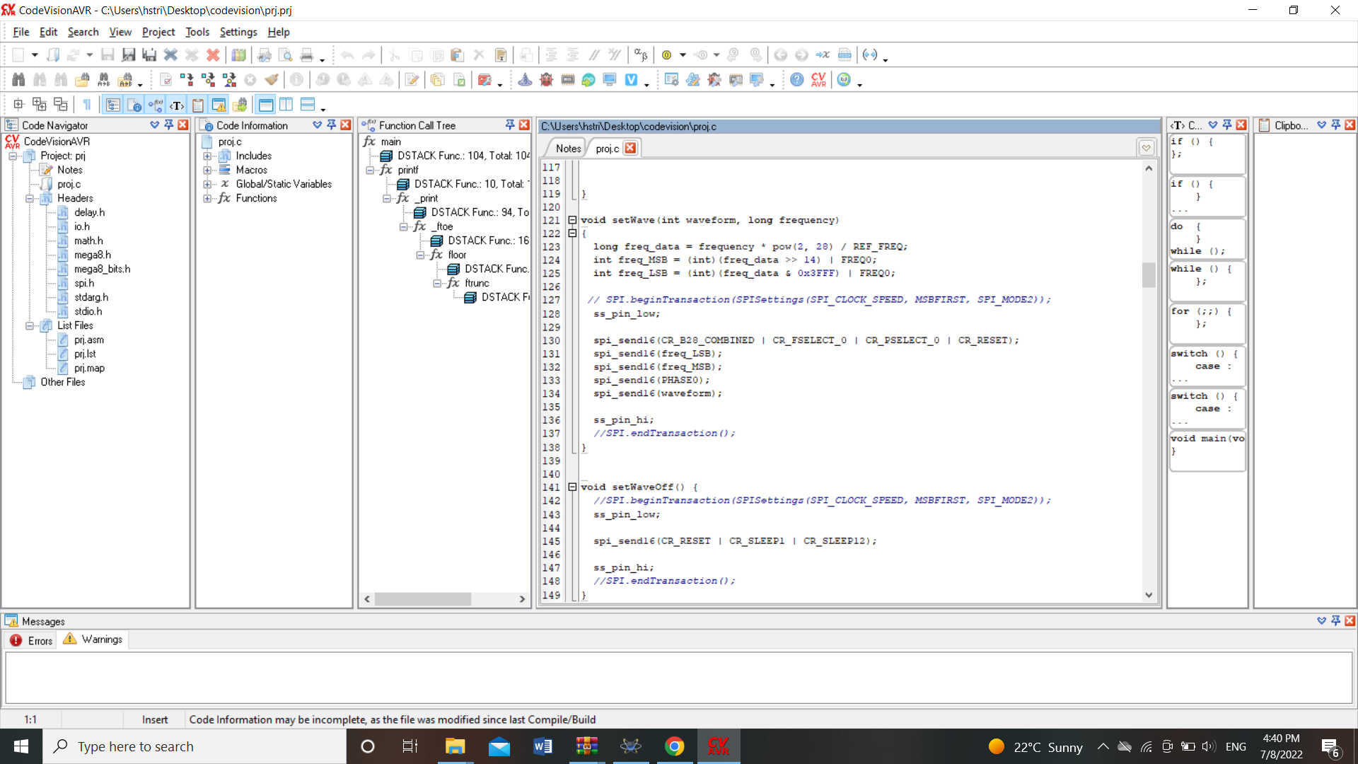
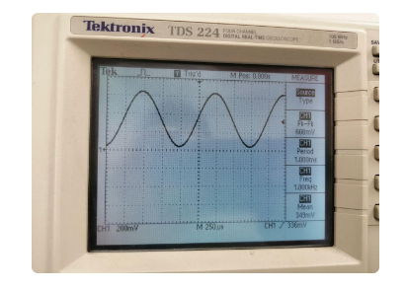
Notes:
The slides must be written with sobriety, without the use of too many colors (strictly necessary) and with short sentences. Line spacing 1-1.5.
Links to movies, pdfs, web pages and so on can be inserted. All hyperlinks must be openable from the ppt.
If there are hyperlinks in the slide, it is advisable to indicate, in the notes field, when the content of the link will be commented: before, after or simultaneously with the mouse click that opens the hyperlink. It is necessary for the Production (USGM) to acquire in advance all the videos downloaded from the Web (for example from YouTube).

Slide 21
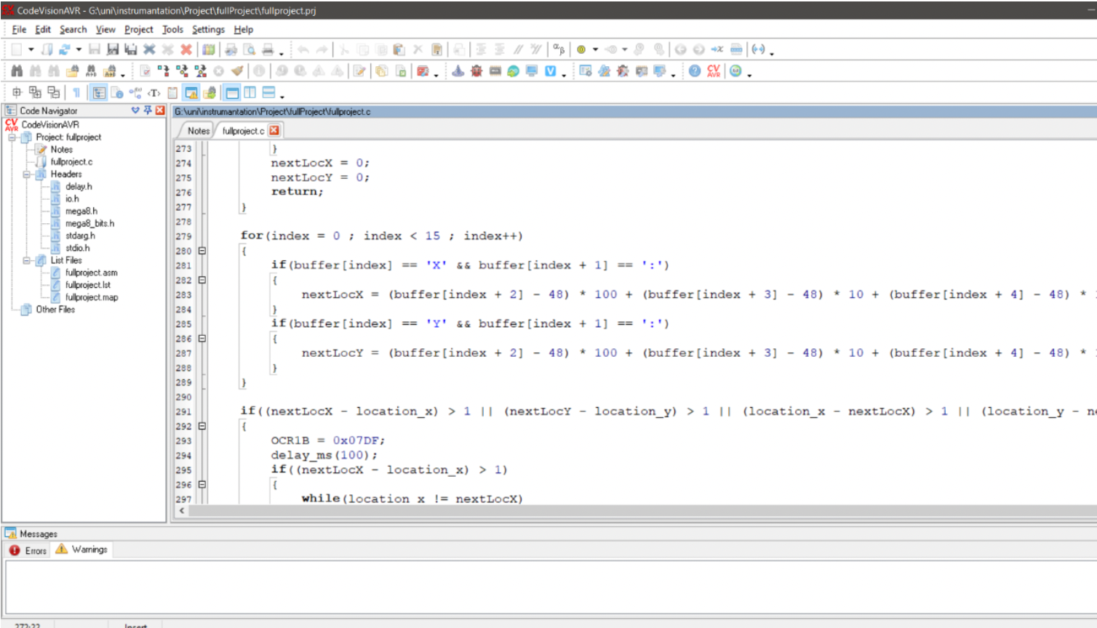
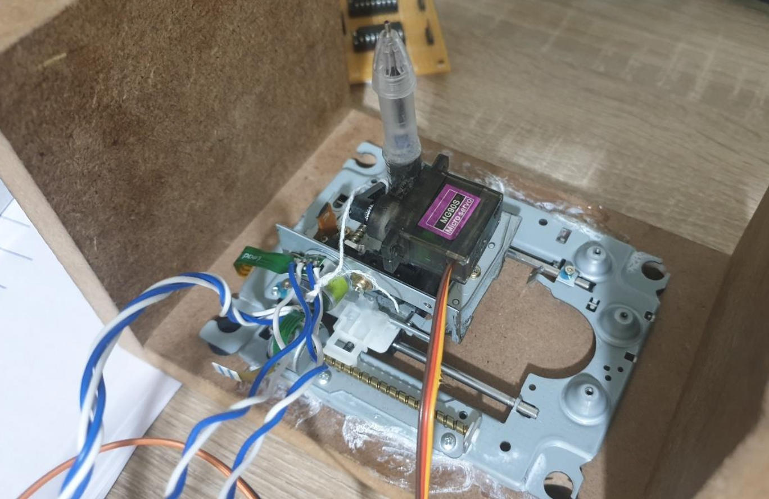
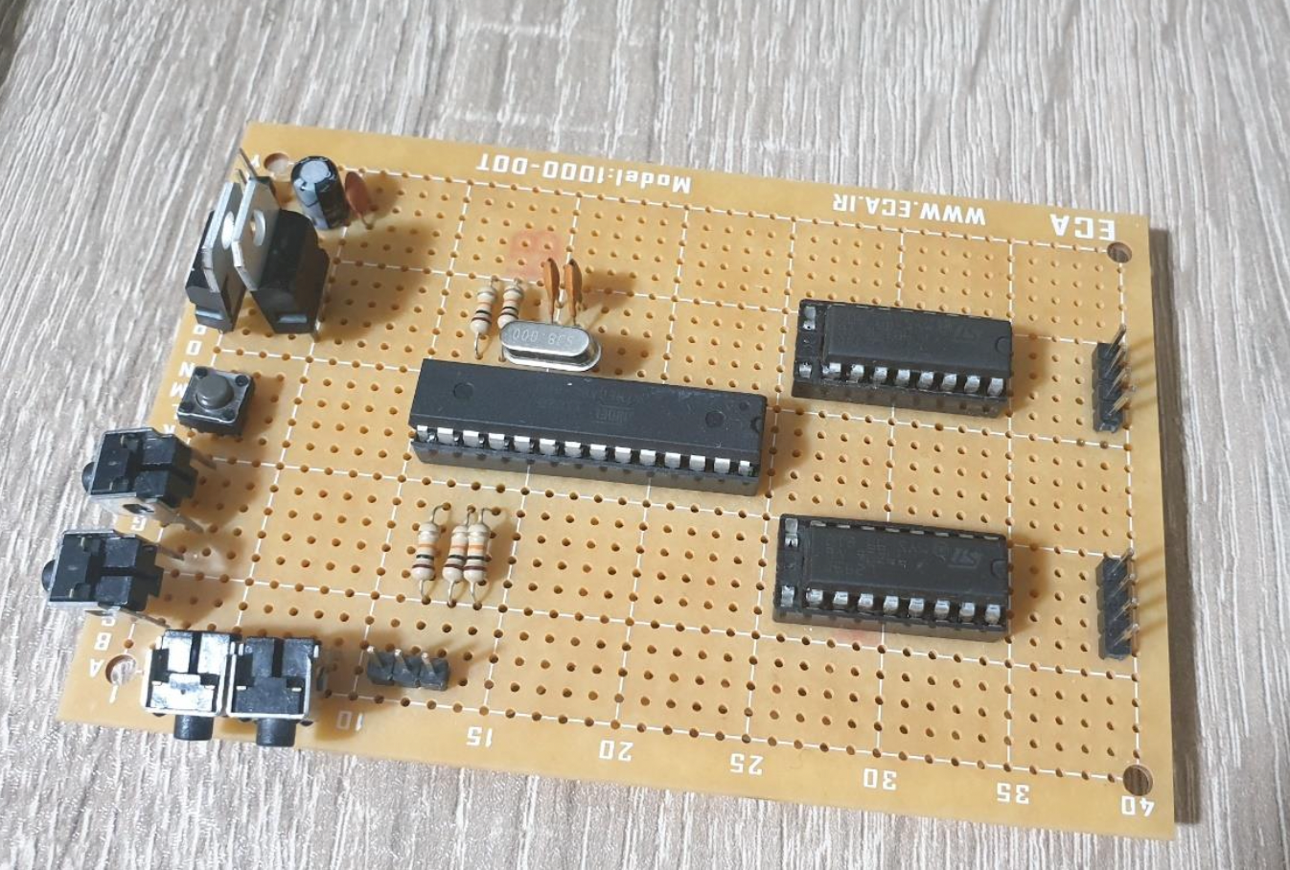
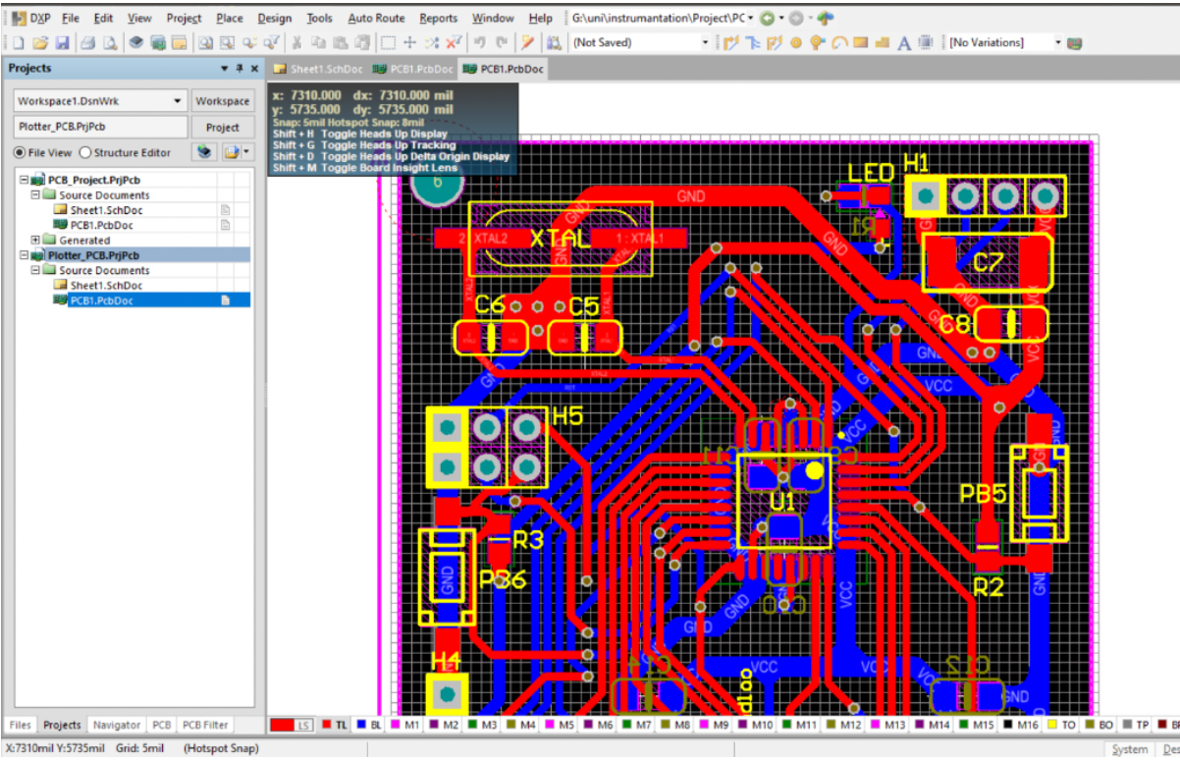
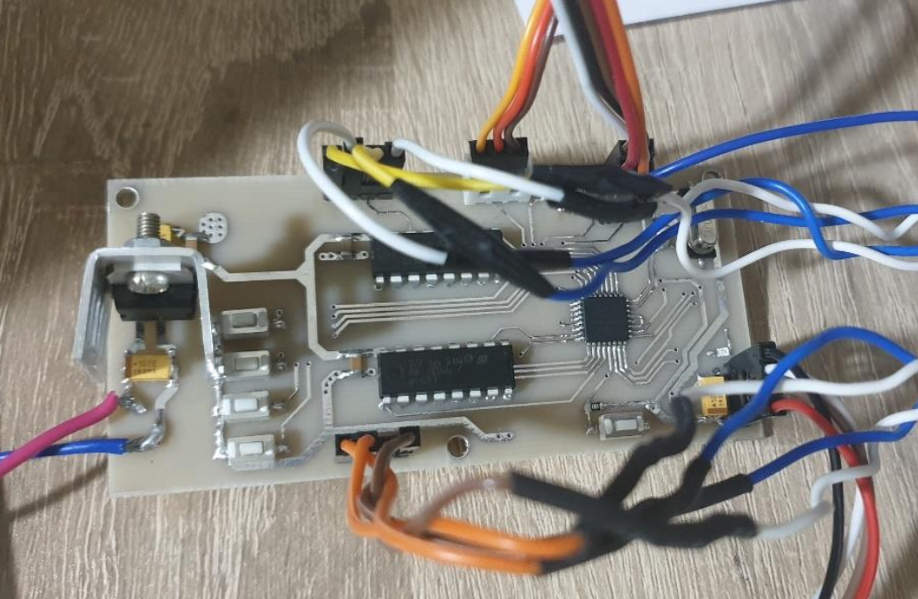
The last Example: Mini Plotter
Notes:
The slides must be written with sobriety, without the use of too many colors (strictly necessary) and with short sentences. Line spacing 1-1.5.
Links to movies, pdfs, web pages and so on can be inserted. All hyperlinks must be openable from the ppt.
If there are hyperlinks in the slide, it is advisable to indicate, in the notes field, when the content of the link will be commented: before, after or simultaneously with the mouse click that opens the hyperlink. It is necessary for the Production (USGM) to acquire in advance all the videos downloaded from the Web (for example from YouTube).

Slide 22
Little Personal Lab!

Slide 23
Conclusions
Learning through the Real World problems makes the student ready for the Real World problems of the Future
On-line learning though Real World examples makes the students enthusiastic to the course
In engineering courses examples coming directly from the industry are more acceptable from students side
Due to the limitation of students for presence in laboratories during on-line learning, the idea of “little personal lab” that could be set up by little monies can help to push the students toward the experiments
Notes:
At the end of each lesson, the teacher should proceed with a summary of the topics covered and take leave using the formula "Thank you for your attention".

